Slide 1
COMPACT BIN
A DREAM OF DECENTRALIZING THE WASTE
Mohd Muzeem(Team Leader & Hardware Designer)
K. Vineesha(Web Developer)
V.Shivaani(Software Developer)

Slide 2
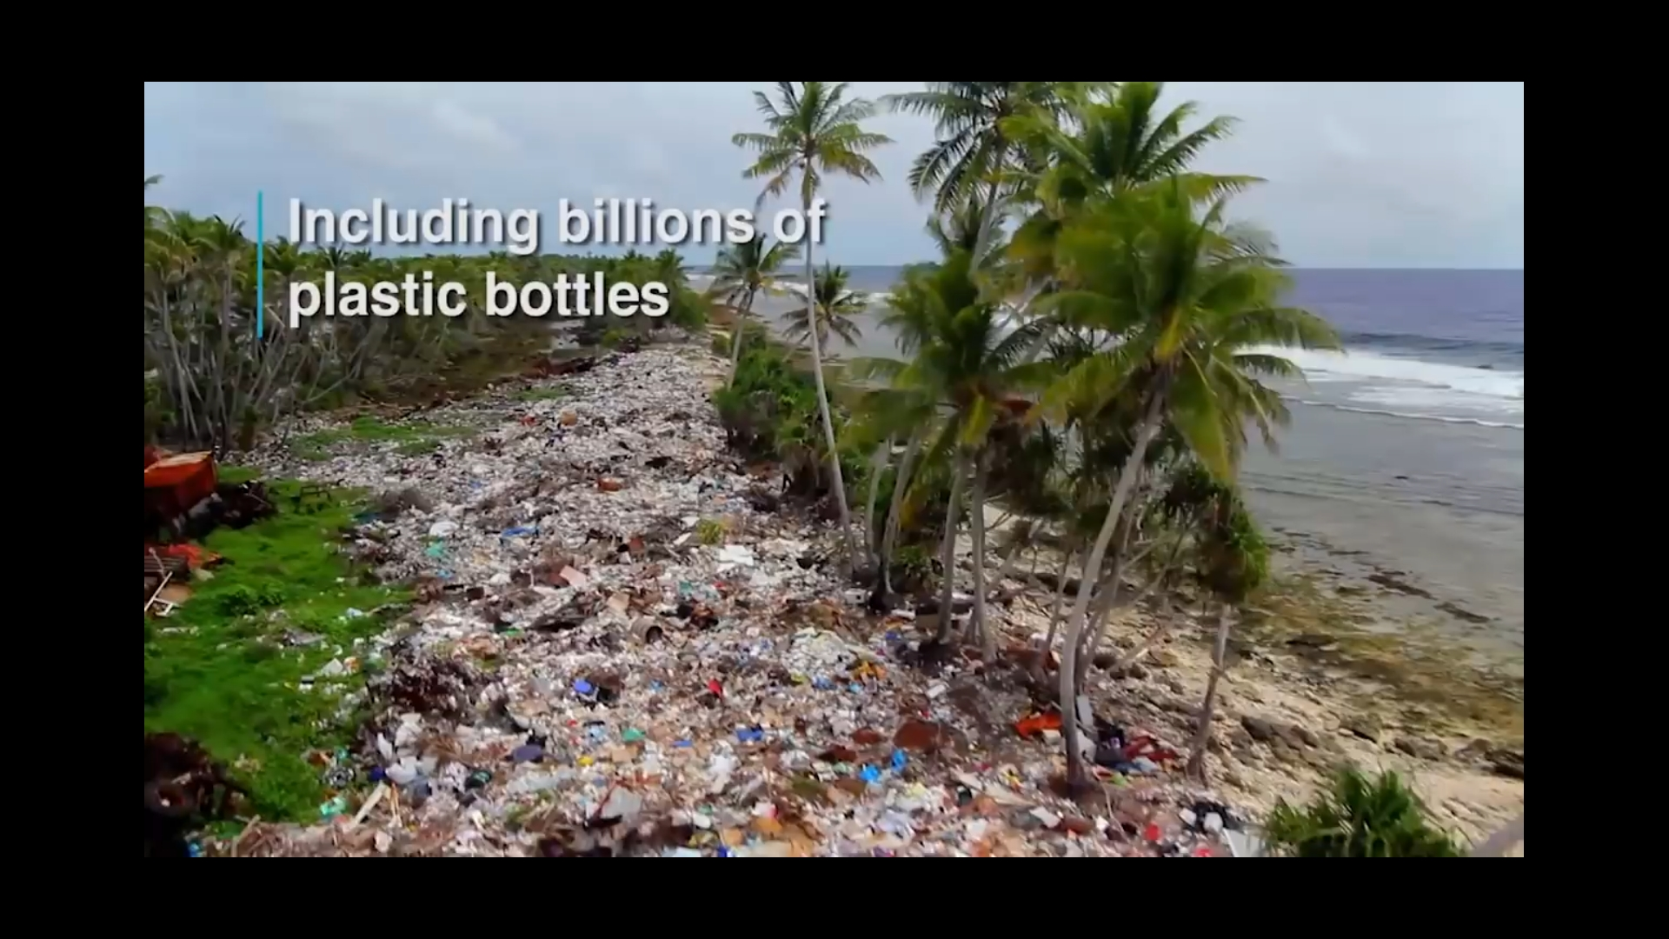
PROBLEM
*Centralized waste management system `
*Inconvenience in recycling
*Enormous cost of transport and labor
*POLLUTION - AIR , LAND , WATER
-LEACHETTE,FOOD,ECOLOGY

Slide 3
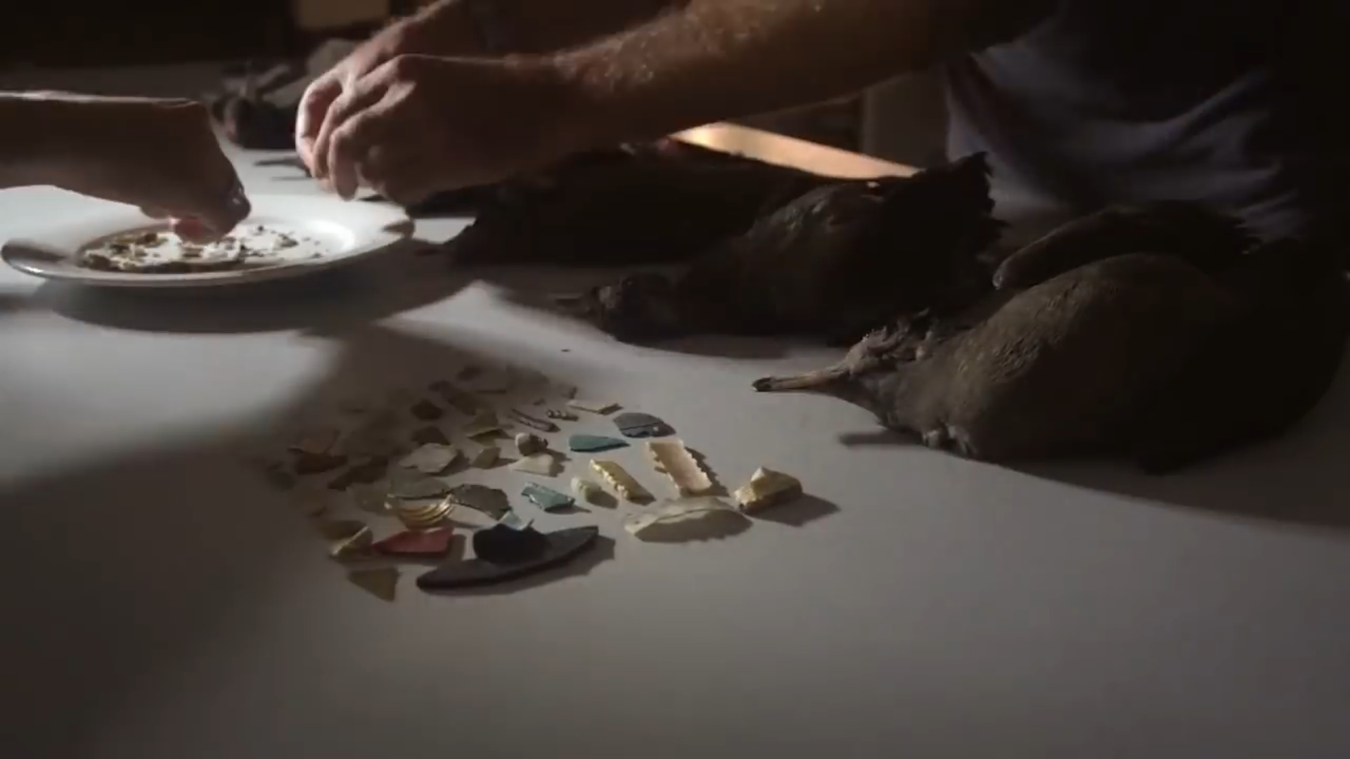

Slide 4
SOLUTION - A HUGE RECYCLING BIN IN A COMPACT PLACE
*A Decentralized system of waste collection and Management
*To Supply compact bins to commercial outlets and households(Apartments)
*Collect the plastic economically and store it in inventories
*Sell it profitably directly to recyclers or processing them to sell it in our online stores

Slide 5
FEATURES
*Electronic tracking of bins and their weights
*Compacting the waste by use of customized shredders
*Incentives to customers
*Rent provision
*Shop where waste get’s it’s true value
*Weight of 1 PET bottle is 13.7 gms , so 1kg of PET = 75 bottles (Hdpe is 112gms , so 1kg = 9 bottles). So,a mini bin of 10 ltr can accommodate 10 kgs of plastic (based on fineness of shredding value may increase.

Slide 6
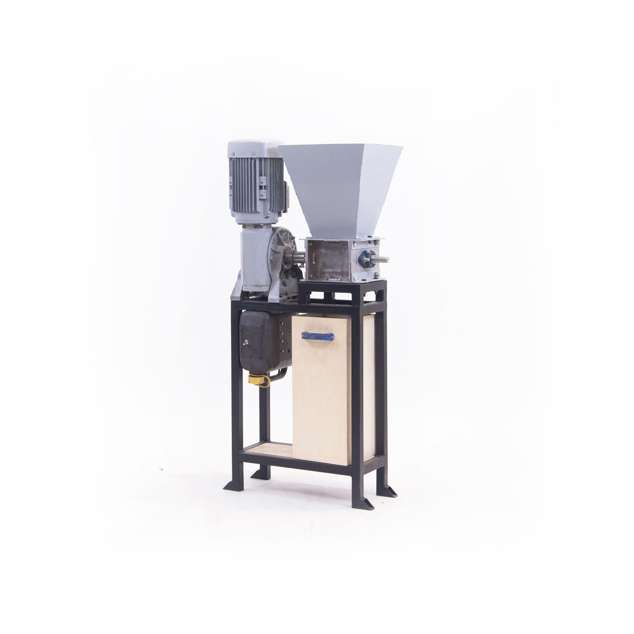

Slide 7
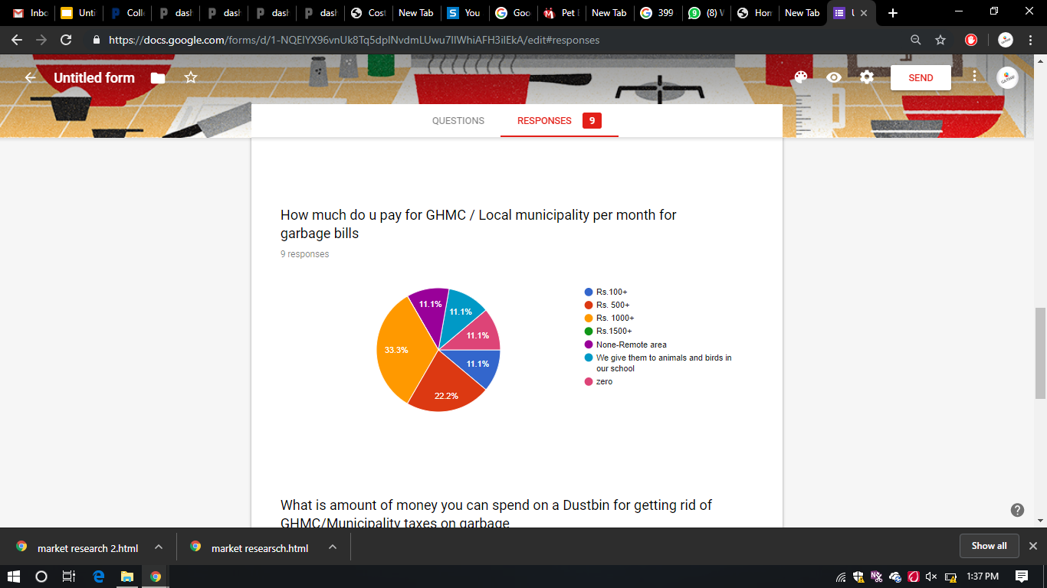
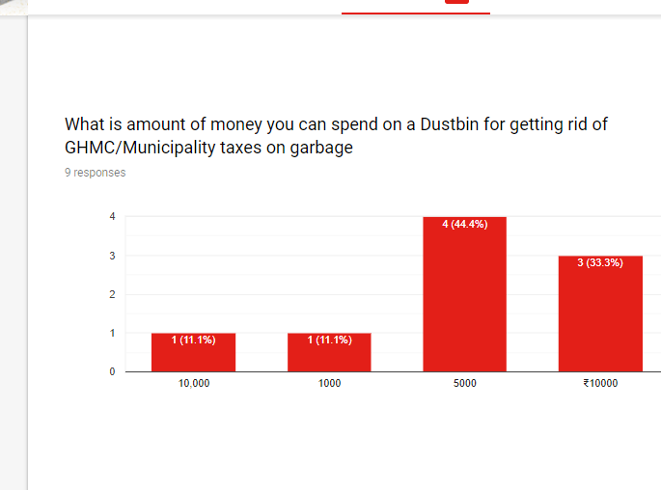
Market research

Slide 8
Product development cost
Mini Bin V 1.0
Material cost of bin + Shredder = 7,000
Electronics cost = 500
Workshop , Labour and service charge = 500
Total =8,000
Commercial Bin
Material cost of bin + shredder = 9,000
Electronics cost =500
Total =10,000

Slide 9
COMMERCIAL COSTS
Transport costs = Rs. 35 / Kilometer (Including all expenses)
Inventory cost =Rs.200 /Tonne/Day
Service charge of Employees = 5% Product cost i.e typically RS.25
Other expenses = Rs. 200 per day

Slide 10
Revenue model
Initial Investment = Rs 50,000
Money from Clients = Rs.40 / Kg of plastic ( Rs 10 as commission and Rs 30 for customer as incentive)
Desired profit from store= 30% (Typically Rs. 60 per piece)
Rentals from Bins = Rs 399 /week/bin

Slide 11
Value statement
*Any Commercial outlet / person which has helped more than 30 kgs of plastic bottles in recycling will be given a Star.
(Self Actualization is something which has nothing to do with brand)
*Every purchase can be linked to social media to improve the social status needs of customer
*Each purchase will trigger a self actualization need

Slide 12
Goals
Reduction in weight of our product accompanied with good power source
Setting up our online store with variety of recycled products like Paper Weights,Tiles,SkateBoards and ornaments too
Widening our product for multi-bins to handle multiple wastes simultaneously.

